Slide 1
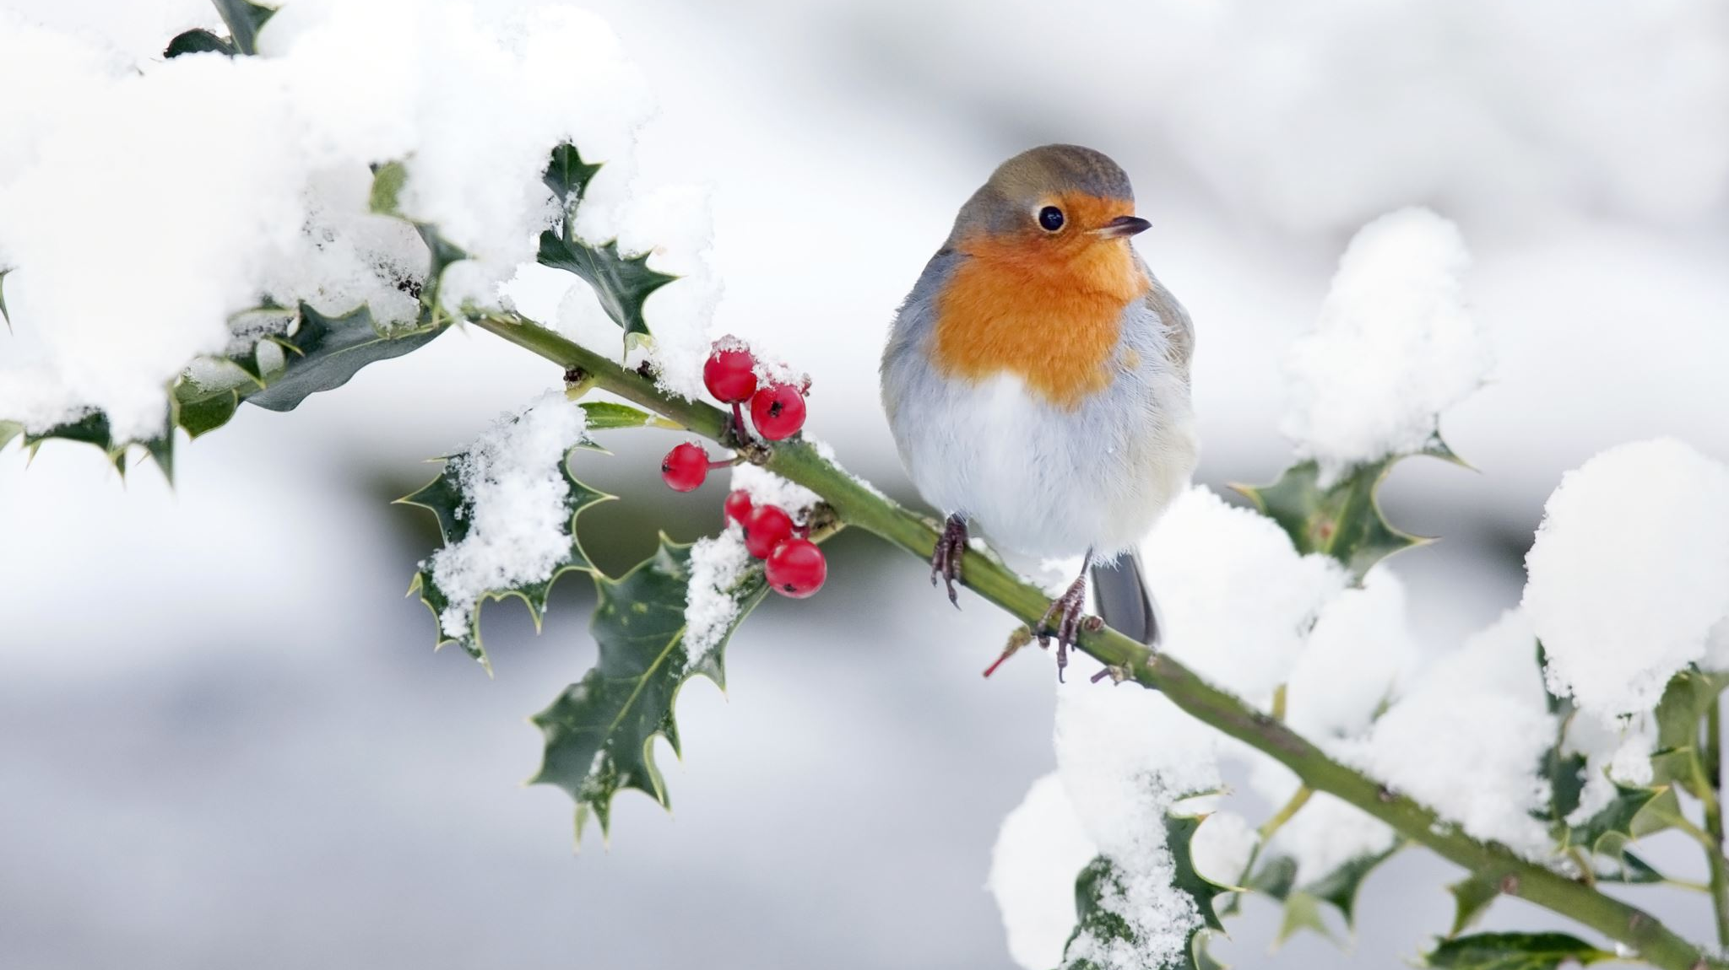
Coping with the Holidays
Alina Craven, MSW, LCSW, RPT
Kristy Dobbins, MSW, LCSWA
Lorven Child and Family Development
264 Greensboro St Ext.
Lexington, NC 27295

Slide 2
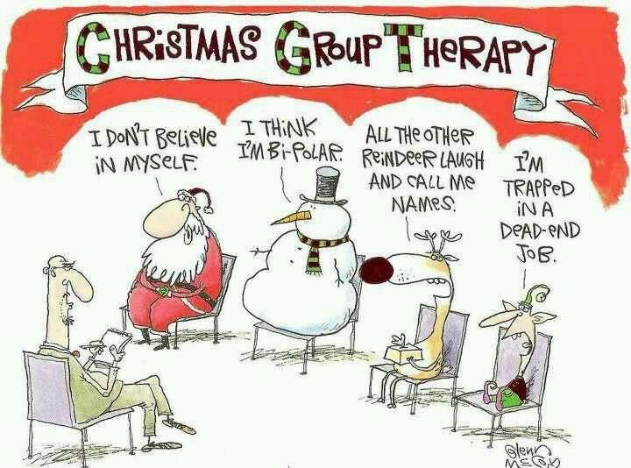
Objectives
Look at what causes stress during the holidays
Discuss ways to decrease stress
Focus on ways to cope and manage stress

Slide 3
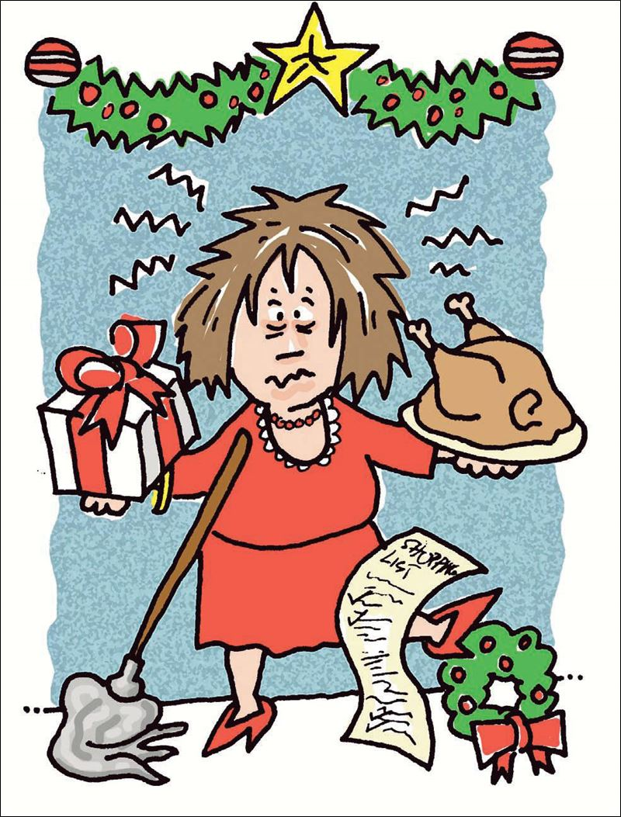
What is your biggest stressor this holiday season?

Slide 4
What makes the holidays so stressful?
Holidays can be a financhial burden
Not having enough time with family or having to much time with family
Pressure of gift giving
Over indulging in food/drink
Wanting everything to be perfect
Having to be organized and maintain a hectic schedule

Slide 5
Common negative emotions experienced during the holiday season
Fatigue
Stress
Irritability
Sadness
Anger
Grief

Slide 6
Positive things about the holidays
Spending time with family and friends
Expressing gratitude for what we have
Celebrate traditions- (spiritual, rituals, cultural, family, and personal)

Slide 7
How do I know if I am stressed?
Physical
Fatigue, sleep disturbance, muscle tension, headaches, gastrointestinal issues.
Thoughts and Feelings
Irritability, anxiety, worry, forgetfulness, low self-esteem, depression
Behavioral Signs and Symptoms
Negativity, procrastination, drug/alcohol use, over eating, lack of self-care

Slide 8
CYCLE OF HOILDAY STRESS
People
"Stuff"
Expectations

Slide 9
Dealing with difficult family members/people
Plan ahead – identify the people who you think will be the most difficult and plan how you want to interact with them
Avoid hot topics
Avoid over indulging (ex. Alcohol)
Letting go of the need for perfection and focus on being present
Practice gratitude- focus on finding something positive about your family and friends.

Slide 10
Boundaries
Boundaries are defined rules or limits that someone established to protect their security and wellbeing around others.
We identify and express how others can behave around us to that we feel safe.

Slide 11
Tips on Setting Boundaries
Give yourself permission to make your safety and comfort a priority
Name your limit- be able to identify and express limits to help you emotionally and physically.
Be consistent- help other understand and hear limits by expressing them clearly. Speak direct, simple, and clear.
I Statements- I feel____ when ______because ____. I need______
You can always start small and work your way up. Seek support if needed

Slide 12
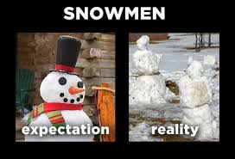
Expectations VS Reality

Slide 13
What are the expectations?
"Idealized togetherness"
Society pushes us to focus on this idea
Expectations from self and others for "the best"
Look the best, dress, the best, have the best, be the best
What are some expectations that you struggle with?

Slide 14
Adjusting Expectations
Do not aim for perfection
Expect things to go wrong
Make realistic plans that are likely to happen. This will make your holiday more enjoyable
Plan how you plan to handle things to the best of your ability. Look at things that have happened in the past for a guide.
Think about contingency plans if possible. Sometimes it is more helpful to be able to "roll with" the changes since it is not possible to plan everything.

Slide 15
How much is enough?
93% of Americans exchange gifts
What makes gift giving stressful?
What is the reason for the holiday gifts?
How do we encourage more meaning
in gift giving?

Slide 16
Stress Management For the holidays, or any time of year
Acknowledge how you are feelings. Do not pretend that everything is fine.
Ask for help if you need to
Volunteer- this is a good way to lift your spirits and help others
Make time for yourself/ selfcare- It can be just 15 minutes per day.
Get in touch with nature
Listen to holiday music or anything music that makes you like.
Give someone a gift who is not expecting it

Slide 17
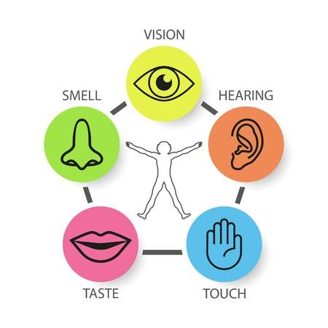
Quick Techniques for Stress Relief
Talk to someone who listens
Practice "Belly breathing"
Visualize a calm and relaxing scene
Do the "Five Senses" Exercise
10 minutes of exercise or stretching
Visualize a calm relaxing scene

Slide 18
Quick Overview
Start your plan now
Recognize what it is in your control and be prepared to roll what is not
Set limits/boundaries
Focus on what is important to YOU

Slide 19
Thank you!
Happy Holidays

Slide 20
Questions?

